Slide 1

Domain Name System
Achyut Thapa (52)
Aadarsha Thapa (51)
Prajwol Manandhar (32)
B.E.Computer Engineering
Kathmandu University

Slide 2
Introduction
What is Domain Name System?
Humans work with names while Computer works with numbers. So there is a barrier in communications. Humans can’t remember all the numbers for different sites and computers can’t understand human language. So, what the bridges that barrier in communication is the DNS. It resolves the domain name into is corresponding IP address. Just like a phonebook, searching for the corresponding number for a name.

Slide 3
IP are stored in servers and if the current server can’t get the IP, next heirarchinal server is requested for it. Heirarchy is given below:
1. Cache-memory(initial search)
2.ISP resolver server
3.Root server
4.Top-level domain server
5.Name server(Final request)

Slide 4
Creating a DNS server
Working with IPv4, UDP
Working with DNS header bit by bit. i.e:Transaction ID,opcode,etc.
Simple response to request

Slide 5
Objectives
Learn how DNS works
Learning about the timing breakdown when a request is sent to DNS server
Creating our own DNS server and working on basic queries

Slide 6
Timing breakdown
Whenever a domain name is used for connection in a browser, the following process takes place:
Initially, the request is queued in the browser. Higher priority requests are completed first.
The request can be stalled in accordance to priority.
After the request, it looks for the corresponding IP address of given domain name. This process is also DNS Lookup.

Slide 7
The initial connection i.e. TCP three-way handshake are underway. And, proxy negotiation takes place.
Finally, the request is sent. After that data is received from the responding party.

Slide 8
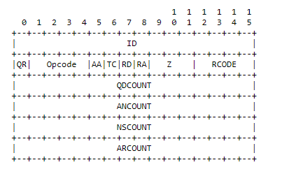
Dns Header Format
ID→Transaction ID
QR→ query/response
Opcode→type of query
AA→Authorative Answer
TC→Truncation
RD→Recurtion desired
RA→Recursion Available
Z→ reserved for future use
Rcode→ response code
QDCOUNT→Question Count
ANCOUNT→Answer Count
NSCOUNT→Nameserver c.
ARCOUNT→Additional Count

Slide 9
PROJECT DEMONSTRATION

Slide 10
THANK YOU !

